Slide 1


MAP Training: Exploring Implementation Processes
Delivery Excellence, May 2019
CONFIDENTIAL – INTERNAL USE ONLY

Slide 2
MAP Training consists of:
Introduction to MAP
Exploring Implementation Processes
Understanding Ongoing Support Model & Processes
This training session is for Exploring Implementation Processes and you will be able to:
Understand the Project Phases and the relevant SOPs
Identify the Implementation processes that are relevant to your functional role
Ensure that the transition from Implementation to Ongoing Support is done correctly
Have a basic knowledge of MAP tools and governance processes.
Build on the knowledge acquired to gain MAP certification using our SmartSolve system
Training Objectives

Slide 3
Project Phases and How They Link Together

Slide 4
MAP Guiding Principle: Consistent Delivery of Projects
Business Development
Phase 01
Plan
Phase 02
Build
Phase 03
Deploy
Phase 04
Support
Phase 05
Understand the Client's Business Needs
Discovery
Gap Analysis
Pricing & Proposal Support
Project Creation
Resource Identification & Allocation
Lay the Foundation
Project Kick-off
Project Monitoring
Risk Management
Change Management
Business Requirements
Test Planning
Status Reporting
Solution Development
Daily Status Meetings
Solution Configuration and Customization
Solution Testing
Configuration Management
Lessons Learned
Iterate (as needed)
Transition to Production
End to End integration Testing
Final Performance Testing
User Acceptance Testing
Client Training
Push to Production
Handover to Support
Proof of Delivery
Hypercare
Hypercare & Ongoing Support
Hypercare
Incident Management
Service Requests & Requests for Change Management
SLA Adherence & Monitoring
Release Management
Product Support
Service & Business Reviews
Key Deliverables
Standard Pricing Estimate
Implementation SOW
PSA Opportunity & Implementation PSA Project Code
Key Deliverables
Internal Kick-off*
Kick-off Deck*
Project Plan*
Business Requirements Document*
Solution Design*
Test Plan*
Key Deliverables
Test Cases*
Executed Test Cases
Traceability Matrix*
High Quality Solution
Client Training Plan*
Key Deliverables
Defect Report*
Production Runbook*
Handover to Support Checklist*
Documented POD
Project Closeout
Key Deliverables
Ongoing Services SOW
Support Project PSA Code
Case Escalation, Evidence & RCA Forms
Product Release Notifications
Service Reviews Deck & SLAs dashboards
Continuous Improvement Log
* Deliverables in colour are mandatory MAP Templates
Notes:
The Key Guiding Pricing of Delivering Projects is based around 5 project phases

Slide 5
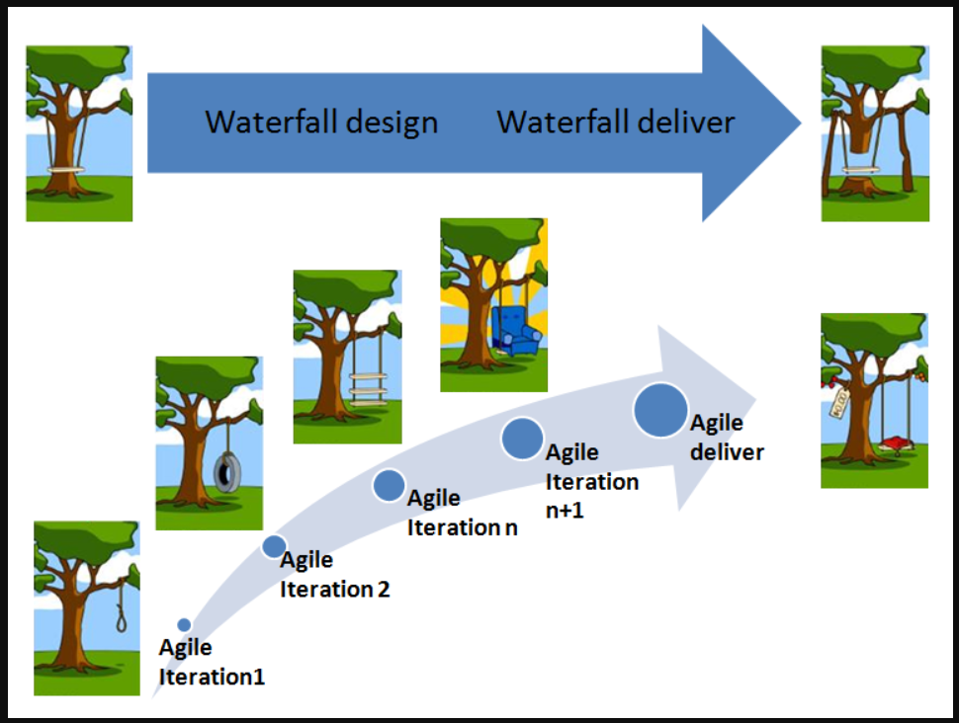
Implementation Methodologies
MAP promotes an Agile-like/Waterfall Hybrid, encouraging flexible methodology
In Waterfall models, before beginning any kind of design or development there needs to be a clear understanding of the scope of work. A detailed project plan will be produced and signed off.
Agile is an extremely flexible model, promoting adaptive planning and evolutionary development. This model is advantageous in project environments where lots of changes need to be handled rapidly and effectively. The customer is involved at every stage for input and provides feedback at regular intervals.
Business Development
Plan
Build
Deploy
Support

Slide 6
Product-specific Statement of Works (SOWs)
SOW templates mirror the project work from Phase 1 to 5 and must be in place for the next phase of the project to start
Subscription SOW
Implementation
SOW
Post Implementation Ongoing Services SOW
Licensing details and fees for the use of the product (and/or use of proprietary data), so for example:
A clear statement of what will be delivered*:
Stakeholders
Delivery timelines
Pre-agreed number of hours to support the client solution:
Tier 1 (Field User Support)
Tier 2 Support (Technical Support & Service Requests)
Client Service Partner
Deliverables by phase
Fees
OCE Sales Subscription SOW
OneKey SOW
Use of Tech Solutions Service Catalogue, as a reference
* Two purposes:
Tells the client what we have agreed to deliver
Tells the Delivery team what we have agreed to deliver
Notes:
With the emergence of OCE as a new product, a lot of work has been done to clarify client contracts.
Three types of contracts or SOWs should now exist for all client opportunities:
Subscription SOW
This is effectively the licence to use a product (like OCE) or to use proprietary IQVIA data such as One Key. Consequently a client may have a data subscription SOW as well as a product subscription SOW
Implementation SOW
This is the agreement linked to the work that will be carried out to develop and build the Client Solution
Post Implementation Ongoing Services SOW
This is the agreement linked to the work that will be done to maintain and support the Client Solution post go-live.

Slide 7
Project Management (PM Processes)

Slide 8
Business Development
PM01 - A process targeted at ‘Go To Market’ teams
Definition:
The Business Development process outlines the steps performed from the identification of an opportunity to the finalization of a client signed contract (e.g. SOW). It also includes the development of pricing estimates for the pricing of the implementation project and of the Ongoing Support contract.
Key Highlights:
Verification of Client Requirements: Is our thinking aligned with the client?
Estimation/Project Sizing: Experience or tools will tell us how long a project might take to implement and hence the cost. Some basic rules are applied. Analysis will also take into account resource costs and availability.
Proof of Concept (POC): In most situations, our experience tells us how we might meet the client’s requirements. Where there is doubt or where we are breaking new ground we may need to prove our ideas. POC may be to prove to the customer we have the capability or to prove to ourselves that something is feasible (optional sub-process).
Proposal & Estimation Preparation: This is a formal response to the client which may include presentations and/or demonstrations, as well cost estimations. Proposal process may be iterative and covers Implementation and Ongoing Service.
Contract/SOW Preparation: After Proposal acceptance, the next step is a formal agreement (Contract) and clear statement (SOW) on what we will deliver.
Key Stakeholders & Roles – PM01
Account Manager
Business Development is owned by the Sales team in each country/region.
Program Implementation Partner / Service Operations Manager / Service Desk Manager
Coordinates with Delivery team to ensure we have knowledge of feasibility, time and cost estimates, resource requirements and initial risks.
Architect
Reviews outline requirements.
Assesses impacts and project sizing/complexity.
Delivery Manager
Ensures opportunity is tracked in PSA.
Ensures that appropriate SOWs are created.

Slide 9
Resource Management & Project Initiation
PM02 & PM03
Definition:
These are the two initial processes for the Delivery team – to bring the project team together and to formally start the project.
Key Highlights:
Resource Management: Ensure that initial resource allocation from PM01 may still be fulfilled. Update PSA with hours assigned per resource.
Communication Plan: Develop plan showing cadence and responsibilities for interacting with the client. Produce parallel plan for team interactions.
Internal Kick-off: Prepare internal kick-off deck. Include the internal communication plan. Hold internal kick-off meeting to ensure that the project team understand the background and objectives of the project, team roles and responsibilities, tools and processes to be followed.
Client Kick-off: Prepare the client kick-off deck. Kick-off deck may include the Communication Plan. Hold the client kick-off call. For larger projects, the kick-off meeting may be a workshop where more detailed requirements are captured.
Client Project folder: Created automatically. Please refer to Audit Information section in PSA Project for location
Key Stakeholders & Roles – PM02/PM03
Project Manager
Define how the project is to be run, bring the team together, initiate contact with the client and start detailed analysis and planning.
Service Operations Manager
Ensure that service and support resource planning takes place at an early stage for handover later in the project.
Delivery Operations
Ensures that all resources are assigned to the project (PSA).
Automatic generation of SharePoint client project documentation folder.

Slide 10
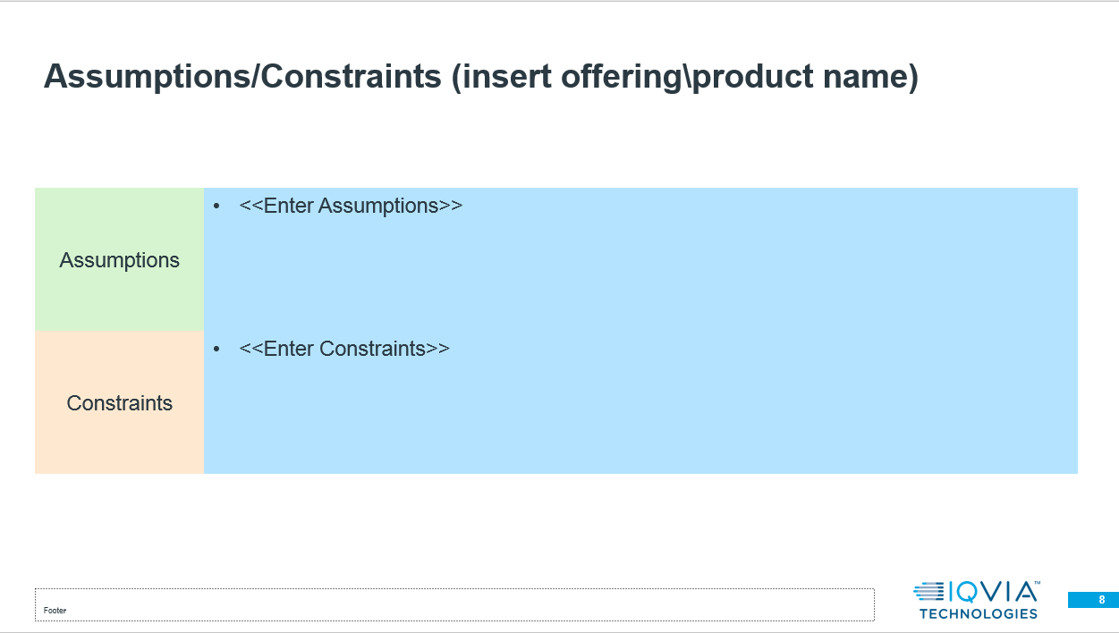
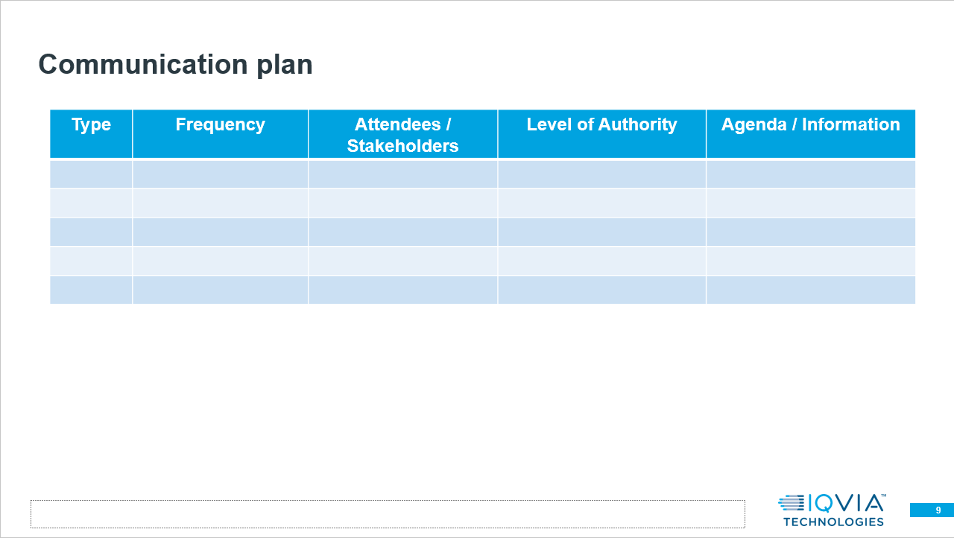
New template: PM03 Kick-off Deck
Kicking-off Deck template
Extracts of Kick-off Deck template key slides

Slide 11
Project Monitoring and Control
PM04
Definition:
A key aspect of any project is to monitor progress by assessing a number of inputs, providing clear status reports, and to identify corrective actions that may need to be taken to ensure that the project stays on track.
Key Highlights:
Governance: Ensure that the MAP processes are being followed.
Change Management: Ensure that any changes are properly tracked using PM06.
Risk and Issue Management: Maintain the Risk and Issue Log and report status to stakeholders according to Communication Plan. Escalate urgent risks and issues (PM05).
Iteration Management: Monitoring iterations (sprints), check that progress is according to plan and that backlog items are prepared for the next iteration (sprint).
Status Reporting: Ensure that stakeholders are appraised of progress in accordance with the Communication Plan.
BRD and Scheduling: Make changes to BRD as necessary and update project schedule. Plan for fixes, enhancements and defect remediation.
KPIs: Used to measure individual project performance – Schedule, Scope, Budget, Risk and Quality are used as standard KPIs in MAP – see Project Central
Key Stakeholders & Roles – PM04
Project Manager
Key responsibility for the Project Manager.
Collates information from various sources and delivers status reports to stakeholders.
Ensures that mitigation plans are in place or that corrective action is taken to keep project on track.
Client/Programme Strategy Partner
These are the key stakeholders for project status information.
Implementation Team
All members of the project team have a responsibility to report progress, updates to risks/issues and feedback on lessons learned as the project proceeds.

Slide 12
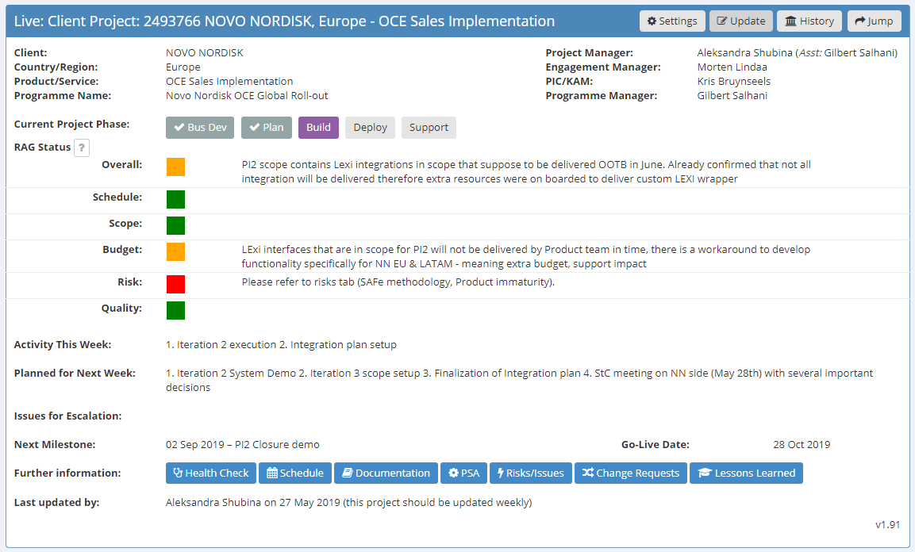
Case Study: Novo Nordisk, Europe – Project Status Reporting
Status Reporting available in Project Central

Slide 13
Risk and Issue Management
PM05
Definition:
Risk and Issue Management is an essential part of any project management methodology and is no different for MAP:
Risk Management is dealing with anything that could impact the project.
Issue Management is dealing with anything that is (or will be) impacting the project.
Both forms of management involve assessing the effect on the project (usually by a scoring system) and having a plan (mitigation) to minimise impact on the project.
Key Highlights:
Risks and Issues Log: All risks and issues should be tracked.
Risk/Issue Scoring: An assessment of Impact needs to be made for Issues. An assessment of Impact and Probability (Likelihood) needs to be made for Risks.
Mitigation Plan: All Risks and Issues should have a mitigation plan to either reduce the likelihood of a Risk turning into an Issue or to reduce the impact.
Ownership: Risks/Issues may be internal or external. Internal Risks/Issues are normally owned by the Project Manager unless they are contractual when they may be owned by Sales. External Risks may be owned by either the Project Manager or a client representative.
Reporting: External Risks/Issues should be shared with the client in ongoing status reports.
Key Stakeholders & Roles – PM05
Project Manager
Maintain Risks and Issue Log (may be tool-assisted – Project Central).
Ensures that all Risks and Issues have mitigation plans.
Risks and Issues are reported to stakeholders.
Client/Programme Strategy Partner
Direct project team on remedial actions as necessary.
Implementation Team
All members of the project team have a responsibility to report and/or update Risks/Issues.
Risks and Issues may be assigned to individuals for action.

Slide 14
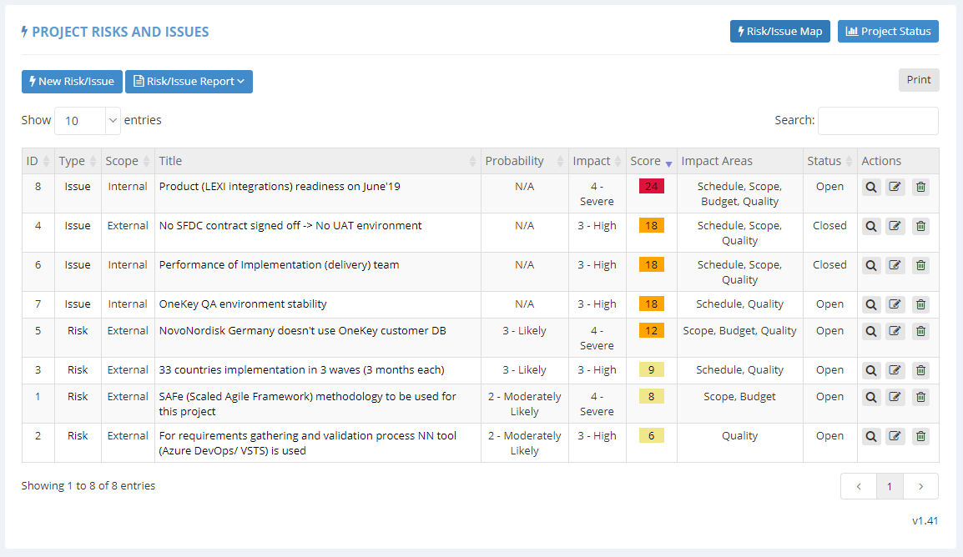
Case Study: Novo Nordisk, Europe – Risk/Issue Log
Risk/Issue Status Reporting in Project Central

Slide 15
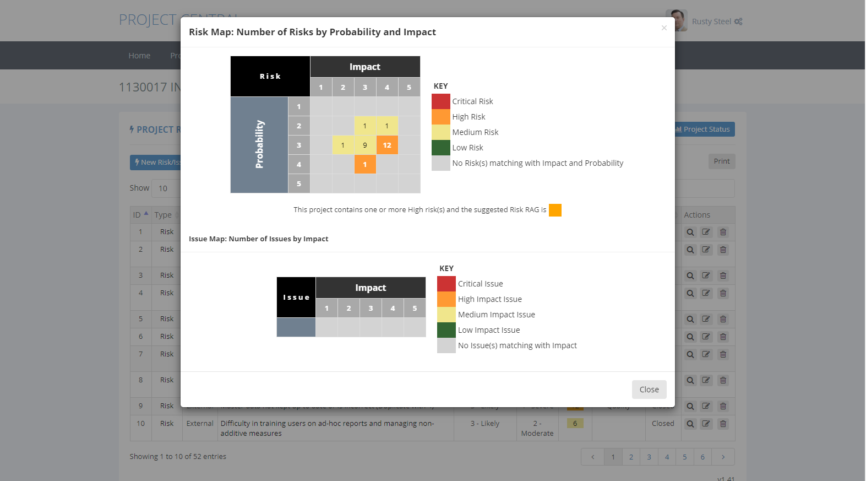
Case Study: Novo Nordisk, Europe – Risk/Issue Log
Risk/Issue Status Reporting in Project Central – shown as ‘heat map’

Slide 16
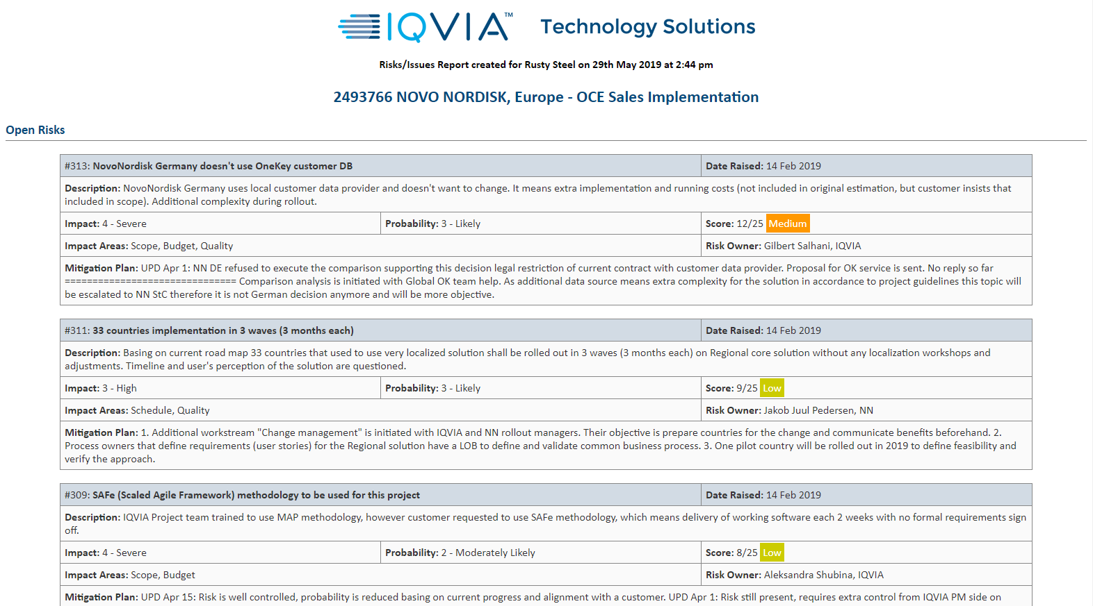
Case Study: Novo Nordisk, Europe – Risk/Issue Log
Risk/Issue Status Reporting in Project Central – when extracted as a PDF client report

Slide 17
Change of Scope Management
PM06
Definition:
This process describes how to manage change within an implementation project. Changes are usually requested by a client after BRD sign-off but change could also be driven internally – a new product release, for example.
Key Highlights:
Change of Scope Log: All changes should be tracked, assessed, estimated and approved.
Assessment: A minor change (eg changing label on a screen) may have no impact on budget or timescale (but could carry risk). A medium change (eg changing extract date from a data file) may have some impact on budget and timescale – these are assessed on a case-by-case basis. Major changes (eg additional data source) may need re-negotiation of the Contract or a new opportunity to be raised in PSA and the PM01 process repeated.
Approvals: All changes need to be tracked, assessed, estimated and approved. Some changes may be rejected but these should still be tracked as a record of the project history. The reasons for change may provide insights into Lessons Learned.
Project Re-baselining: The BRD, Project Schedule and Risks/Issues Log may need to be updated after a change has been approved.
Key Stakeholders & Roles – PM06
Project Manager
Maintain Change of Scope Log (may be tool-assisted – Project Central).
Ensures that all changes are tracked, assessed, estimated, and approved by the client for client-driven changes.
Significant changes may require re-negotiation of the contract.
Client / Programme Implementation Partner
All changes should be approved.
Business Analyst / Architect
Assist with the analysis, impact assessment and estimation of effort (and hence, cost).

Slide 18
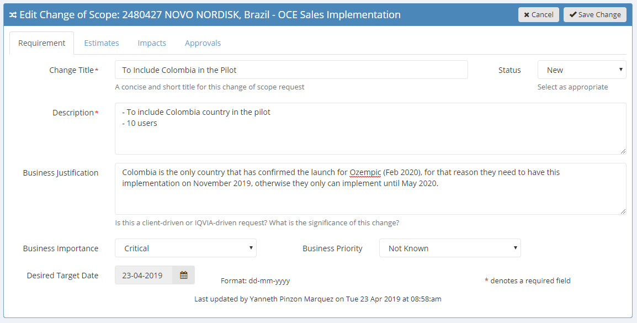
Case Study: Novo Nordisk, Brazil
Change of Scope Tracking in Project Central

Slide 19
Business Requirements
PM07
Definition:
This process describes the capturing of the Client’s business requirements leading the completion and approval of a Business Requirements Document. Once approved, any changes are then subject to the Change of Scope Management process. This is a key project document that drives the project and provides a detailed description of Client expectations.
Key Highlights:
Significant Client Input: Builds on the SOW and adds fine detail. Meetings with Client may be calls, face-to-face meetings or one or more workshops depending on the size and complexity of the project.
BRD Construction: The BRD is a critical document from which the Solution Design is derived and all subsequent work planned. This has to be detailed enough and accurate. Client approval (sign-off) is important as a verification by the Client that the Delivery team has understood the Client’s requirements.
Client Approval: Should be obtained before further planning is undertaken or further MAP phases initiated.
Key Stakeholders & Roles – PM07
Business Analyst
Key point of contact between Client and the project team.
Elucidate requirements from the Client by meetings or workshops.
Write the BRD and seek Client approval after internal review.
Delivery Team
Input may be needed from the Architect and/or Technical Lead to ensure the right level of information is captured.
Input may be needed from the Service Management team to ensure that Ongoing Support needs are covered.

Slide 20
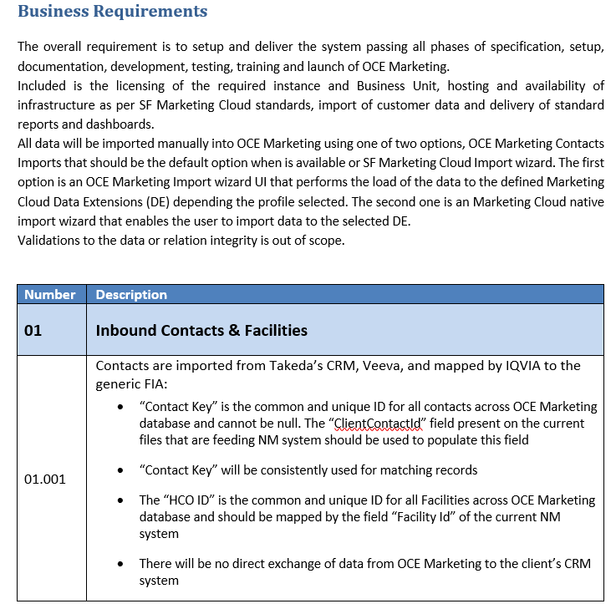
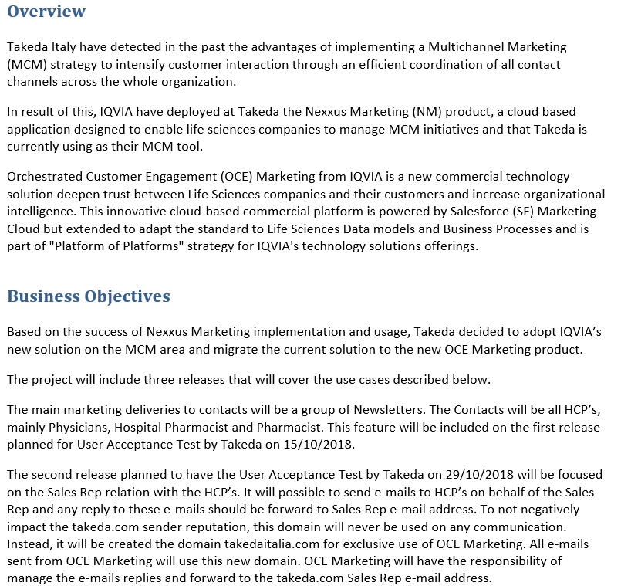
Case Study: Takeda Italy – PM07 Business Requirements Document
Capturing the Client’s business requirements in a consistent way to ensure understanding across teams globally
Extracts of key pages, as per BRD template

Slide 21
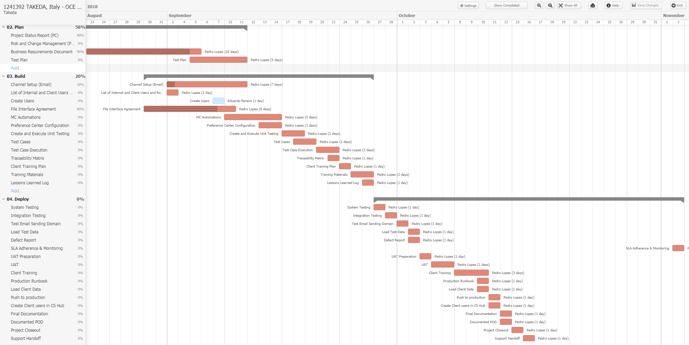
Case Study: Takeda Italy – Project Schedule
Visual Status of project progress maintained in Teamwork

Slide 22
Traceability
PM08
Definition:
A Traceability Matrix is used to show that all requirements have been delivered and satisfactorily tested.
It has value for IQVIA as well as the client and may be expected evidence in a client audit.
A Traceability Matrix contains itemized requirements, associated specifications, related test cases and results of those tests.
Key Highlights:
Traceability Matrix Creation: The Traceability Matrix is reviewed by the Business Analyst to verify that all business requirements lead to functionality that in turn is associated with relevant test cases.
Traceability Matrix Verification: As part of the review of test results (see QM01 Test Management), it should be proven that all desired functionality is present and operational.
Key Stakeholders & Roles – PM08
Testing Lead
Reviews business requirements.
Creates traceability matrix.
Populates traceability matrix.
Business Analyst
Reviews traceability matrix.
Identifies gaps in matching test cases to business requirements.
Raise defects where testing shows that functionality resulting from business requirements is missing or broken.

Slide 23
Iteration Management
PM09
Definition:
Iteration Management becomes important when a large project is broken down into a more Agile-like structure where discrete chunks of work (work packages) are delivered in iterations (sprints). The solution is thus delivered incrementally with reviews after each iteration has been completed and a planning session to plan the next iteration. The iterative process may extend to the Plan and Deploy phases.
Key Highlights:
Iteration Planning Meeting: Decides the content of the next iteration.
Iteration Review Meeting: Determines what worked well, what didn’t work well and general lessons learned from the previous iteration.
Retrospective with Client: Held if iteration delivered a component visible to the Client or if the Client was involved in the iteration.
Key Stakeholders & Roles – PM09
Project Manager
Holds iteration planning meeting.
Updates backlog and initiates solution design.
Holds review meeting for previous iteration.
Holds retrospective with Client (optional and dependent on project)
Implementation Team
Provides feedback on previous iteration.
Identifies items for next iteration.

Slide 24
Client Training
PM10
Definition:
This process ensure that any necessary Client training is delivered. Training and training activities are budgeted for in the Proposal and there may be a choice of training models that may be aligned to a chosen support package. IQVIA may train end-users directly or adopt a champion model, whereby we train the in-house Client trainer.
Key Highlights:
Training Needs Analysis: Analysis of Client needs as an input to creating the Training Plan.
Training Plan: Documentation of the agreed training model, depth and breadth of training, intended audience, logistics, and schedule.
Language: Training may be delivered by a local IQVIA office in the local language. The ‘Train the Trainer’ approach may involve training an English speaker in the Client organisation who will then deliver the training in a local language.
Training Delivery: Training may be on-site or remote and should be defined in PM01 Business Development.
Key Stakeholders & Roles – PM10
Training Lead/Trainer
Creates Training Needs Analysis and Training Plan.
Develops training materials.
Executes Training Plan.
Project Manager
Coordinates training to be delivered after a successful completion of UAT.
Obtains Client sign-off that training has been completed and solution is ready to go live.

Slide 25
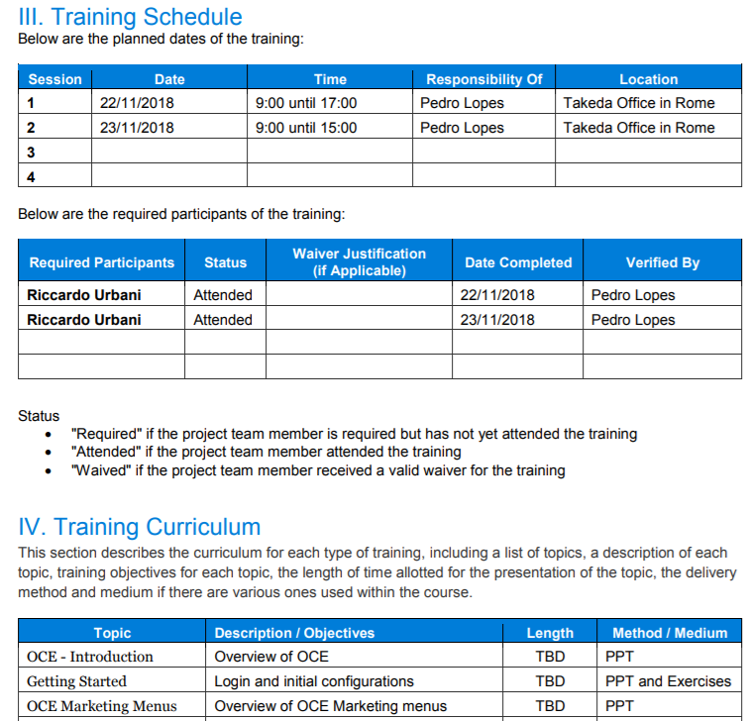
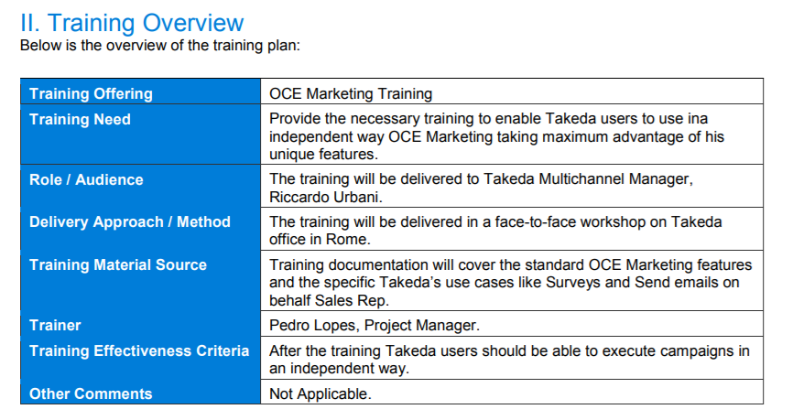
Takeda Italy – PM10 Client Training Plan
Securing the training needs upfront

Slide 26
Proof of Delivery
PM11
Definition:
This process is a formal acknowledgement by the Client that the solution has been delivered and handed over, triggering the final stage of revenue recognition from a finance perspective.
Key Highlights:
Client Notification: Formal notification to the Client that the project is complete, has been delivered and is in Production.
Client Acknowledgement: Confirmation from Client representative that solution has been handed over.
PoD Record Created in PSA: A copy of the confirmatory e-mail from the Client should also be stored in the PSA record.
Key Stakeholder & Role – PM11
Project Manager
Formal notification to the Client that the solution is in Production (Live).
Sign-off/acceptance by Client that the solution has been delivered, passed UAT, training delivered and any other handover performed.
Creation of a Proof of Delivery (PoD) record in PSA.

Slide 27
Transition from Implementation to Ongoing Support

Slide 28
Handover to Support
PM12 – Preparing Service Operations teams to handle Client Ongoing Support
Definition:
Once implemented, a project will be handed over by the Project Manager to the Service Operations team to provide Ongoing Support.
The Project Manager and team needs to prepare a set of handover documents that will be reviewed by the Service Operations team and used during the handover meetings. These documents will also be used by the Client Service Partner for future references to the project.
Key Highlights:
Project Documentation: Key documents are posted to the SharePoint site and introduced by the project to the Service Operations team.
Documentation Approval: Review all documents and send them back to the Project Manager team, if needed, until all clear/approved,
Handover to Support Checklist: Sign-off of the Handover to Support checklist by Project Manager, Client Service Partner & Service Operations.
Transition to Support: Handover to Support Checklist Template transitions to the Client Service Partner, who organizes and delivers the Client kick-off meeting and confirms that Ongoing Support is live with a clearly defined period of Hypercare.
Key Stakeholders & Roles – PM12
Project Manager
Introduces project to Service Operation Teams. Adds documents to SharePoint and signs-off checklist.
Business Analyst/Technical Lead
Reviews application specificities, updates or adds documents.
T1 – Service Desk, T2a – Service Operations, T3 – Product Operations
Reviews documents and signs-off checklist.
Client Service Partner
Coordinates the entire process.
Reviews documents, signs-off checklist, chairs Client kick-off meeting and confirms when support is live.

Slide 29
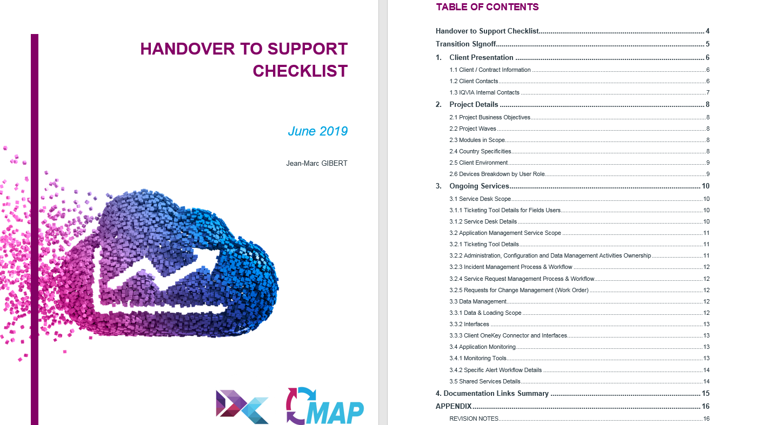
Handover to Support Checklist TOC

Slide 30
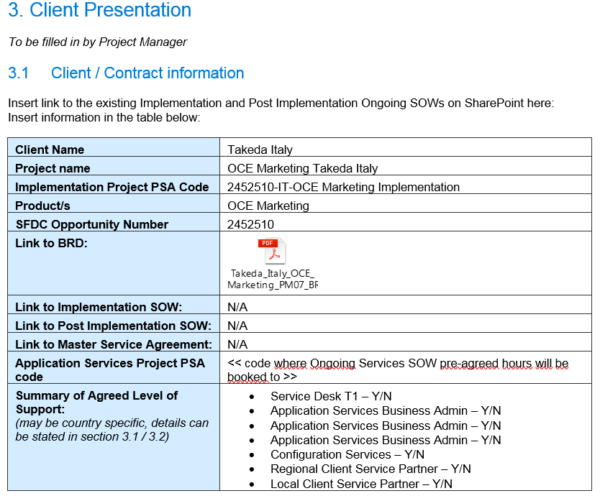
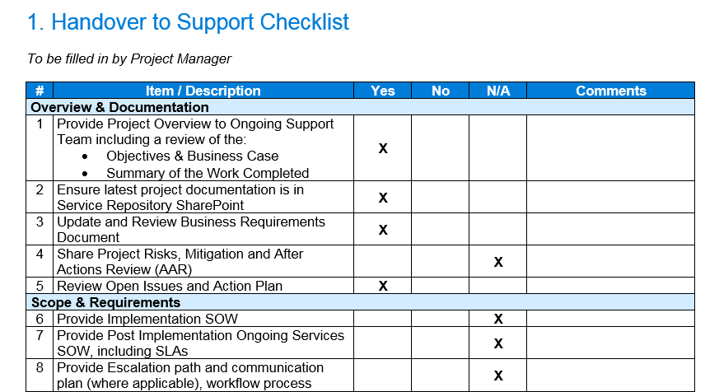
Case Study: Takeda Italy – PM12 Handover to Support Checklist (*)
Ensuring effective handover from implementation teams to ongoing support teams
(*) please note this document has been updated in December release of MAP

Slide 31
Hypercare
PM13 – Ensuring end-users support and application adoption post rollout
Definition:
Hypercare is the period of time immediately following a system Go Live where support is available to ensure the seamless adoption of a new system and a smooth functioning of the application.
Key Highlights of the Hypercare Standard Operating Procedure:
Technical Support: The Service Operations team receives and drives the resolution of technical queries and liaises directly with the Project Manager and team for any escalations.
Training Support: Access to the training team to promptly address end user queries and application misuse.
Configuration Issues and Queries: Project Manager and team receives escalated cases and prioritises standard configuration issues to ensure smooth functioning of the application.
Handover to Support: The Hypercare phase validates the information provided within the Handover to Support checklist, to ensure that any client-specific processes are clearly understood by the support team.
Standard Hypercare Period: 2-4 weeks, depending on the size of the project.
Key Stakeholders & Roles – PM13
Project Manager
Organizes Kickoff Support Meeting and acts as a subject matter expert.
T2b – Developer
Develops and provides resolution on escalated enquiries.
T1 – Service Desk Lead
Manages Field Users enquiries.
T2a – Service Operations Lead
Manages Service Desk escalations and Champion Users enquiries. Updates cases.
Client Service Partner
Monitor cases, chairs Hypercare weekly meeting, and closes Hypercare period..
Notes:
Milestone in Hypercare.
1 or 2 people assigned to Hypercare
Project closes after Hypercare phase ends

Slide 32
Technology Management (TM Processes)

Slide 33
Solution Design
TM01
Definition:
This process takes the Client’s business requirements, as documented in the BRD, and translates them into a technical specification to enable the solution to be developed. The Solution Design takes into account all aspects of the proposed solution and covers the high-level software architecture along with designs for the data model, integration, ETL and reporting.
Key Highlights:
Analysis of Business Requirements: Analysis of business requirements to assess the need for a custom design or an ‘off-the-shelf’ implementation.
Creation of Solution Design: Documents at a technical level all the information and specifications needed to develop and/or configure the solution. An off-the-shelf implementation may use a standard product-specific template with minor amendments needed for configurational details. A custom application may start with a template but may include more detail on custom elements.
Solution Design Approval: Solution Design will need peer review (project team members) and/or approval by a senior architect, design approval board, product management or other bodies external to the project team.
Key Stakeholders & Roles – TM01
Architect
Analysis of business requirements.
Construction of Solution Design document.
Assists with the review and sign-off of Solution Design.
Project Manager
Accountable for the production of the Solution Design and review/approval steps.
Implementation Team/Product Management
Provide advice, input, guidance and approvals where necessary.

Slide 34
Configuration/Development
TM02
Definition:
This is the construction of the Client solution based on the specification described in the Solution Design. An ‘off-the-shelf’* solution may just require configuration. A more complex solution with custom elements may require more technical development work. Care has to be taken not to break the SaaS model and make future upgrades and maintenance more difficult.
Key Highlights:
Configuration/Development: Extent of configuration and/or development is dependent on the offering.
Devise and Construct Unit Tests: These are to verify that the functionality requested in the Solution Design has been delivered. Unit tests should be peer-reviewed by the Technical Lead.
Peer Review of Code: Ensure that standards are being followed and that best practice has been adopted.
Code Check-in: Depending on the offering, the configuration or code should be checked into a Code Management System (CMS) – this may be product-specific. See also TM03.
Key Stakeholders & Roles – TM02
Technical Lead
Accountable for much of the process.
Provides guidance and leadership to the Developer(s).
Approve unit test cases.
Developer
Configure product and/or develop custom code.
Devise and execute unit test scripts.
Seek peer review of code and adherence to good programming practice.
Architect
Provide advice, input, guidance and approvals where necessary.
* Also sometimes called ‘out-of-the-box’

Slide 35
Configuration Management
TM03
Definition:
This process ensures that all components of a build* are identifiable and have been correctly assembled. Code is tracked in a Code Management System (CMS). Code versions are identifiable. Configuration Management also extends to the clear labelling of document deliverables with dates, version numbers and editors being tracked within the document and sometimes forming part of the stored document filename.
Key Highlights:
Code Check-in: Depending on the offering, the configuration or code should be checked into a Code Management System (CMS) – this may be product-specific.
Build: Usually an automated process that takes checked-in code or configuration to create an intermediate build for testing purposes.
Testing: Ensuring the integrity of the build before passing to the Test team for regression testing for a specific iteration and for specific functionality testing.
Key Stakeholders & Roles – TM03
Technical Lead
Accountable for much of the process.
Ensures that Configuration Management process is maintained.
Developer
Check-in of code.
Submitting code for an automated build process (where applicable).
Validating build.
Roll-back of build if errors are found.
Deploy build to non-Production environments as necessary.
* A ’build’ is an internal release

Slide 36
Push to Production*
TM04
Definition:
This process is the deployment of the final tested build into the Production (Live) environment. The build may be released into a Pre-Production environment first that simulates the Live environment with similar data volumes and integrations with other components. Testing here ensures that the build is good and that the deployment process is good. This is a strictly-controlled process especially when deploying upgrades to a solution already in Live operation.
Key Highlights:
Go/No Go Criteria: This is usually a simple checklist verifying that testing is complete, no significant issues are outstanding, UAT has been successfully completed, training has been delivered where agreed, handover to support has been completed, all comms have been performed and approvals gained etc.
Release: The release process is specific to each offering and should be followed precisely and recorded for later audit or debugging purposes.
Release Checks: Basic checks (smoke tests) performed by IQVIA staff. Further checks performed by the Client.
Notifications: Sent to stakeholders to notify that a release has been made.
Key Stakeholders & Roles – TM04
Project Manager
Confirm Go/No Go criteria and status.
Comms to Client and internal stakeholders.
Technical Lead
Coordinate code push to Pre-Production and Production environments.
Ensure that basic build checks and smoke-testing are performed.
Ensure that fixes to issues are swiftly implemented.
If critical issues cannot be fixed, oversee a roll-back of the code.
Validate Production Runbook.
Architect/Business Analyst
On hand to provide advice as necessary.
* Sometimes referred to as ‘Release Management’

Slide 37
Fixes / Enhancements
TM05
Definition:
This process covers fixes necessary as a result of Defect Management as well as minor enhancements (Changes of Scope) that do not exceed the threshold defined for contract re-negotiation or triggering a new opportunity in PSA.
Key Highlights:
Estimation: Depending on the nature of the fix or enhancement, this step may involve the Business Analyst, the Technical Lead and/or the Architect.
Criteria Assessment: If an enhancement, it should be escalated to a Change of Scope Request if it exceeds a pre-defined threshold defined in terms of budget, timescale and risk.
Update of backlog: Fix/enhancement added to backlog for inclusion in a future iteration. Nearness of target iteration is determined by the priority given (if a blocking issue then it will be high priority).
Key Stakeholders & Roles – TM05
Project Manager
Ensure that the enhancement is below the Change Request threshold.
Prioritise fix/enhancement and add to backlog for inclusion in a future iteration.
Business Analyst/Technical Lead/Architect
Scope out work and provide estimate of work needed.

Slide 38
Quality Management (QM Processes)

Slide 39
Test Management
QM01
Definition:
This process provides a standard approach for managing Implementation Testing and is to be followed when managing the testing and defects found across all testing phases (System, Performance, Integration and User Acceptance Testing).
Key Highlights:
The bigger picture: The Test Management process brings together each of the other processes in the Quality Management workstream:
Determines whether a Test Plan needs creating or updating (links to QM02).
Determines whether System, Performance, Integration or User Acceptance Testing are required (links to QM03, QM04, QM05, QM06 as appropriate).
Determines whether UAT will be performed by the Client (links to QM06 and PM04).
Links to Defect Management (QM07) and Risks & Issues (PM05).
Initiates Test Completion activities such as archiving of test artefacts, updated living documents (BRD etc) and UAT test cases in the project repository (links to PM08).
Key Stakeholders & Roles – QM01
Testing Lead
Test Plan updates, decision on testing types testing required, test completion activities.
Tester
Defect/Risk/Issue identification.
Project Manager
Decision on Client UAT involvement.
Storage of executed UAT scripts in Project Repository.
Implementation Team
Update documentation based on any impacted by the QM processes.
Client
Test Plan approval.
UAT execution.

Slide 40
Test Plan
QM02
Definition:
This process outlines the overall testing approach, including the test scope, types of testing, test phases, testing priorities and objectives, test coverage, test data, resource planning and environment planning.
Key Highlights:
Test Plan template (General content): This comprehensive document covers a variety of information, including it’s purpose, the intended audience, test environments, hardware/data requirements, communication plan, tools, training, test case management, defect management and escalation.
Test Plan template (Testing approaches): The template includes the approaches for System, Performance, Integration and User Acceptance Testing approaches, covering:
Testing Scope.
Testing Objectives.
Testing Resources.
Testing Entry / Exit Criteria.
Testing Assumptions and Dependencies.
Testing Risks & Mitigations.
Testing Schedule
Key Stakeholders & Roles – QM02
Testing Lead
Review Test Plan with Business Analyst.
Tester
Identify Client’s testing requirements.
Update/Publish Test Plan.
Project Manager
Decide whether Test Plan will be reviewed with the Client.
Coordinate updates following Client review.
Business Analyst
Determine changes to the Test Plan.
Test Plan approval.

Slide 41
System Testing
QM03
Definition:
This process defines the steps to test functional requirements of each individual component in order to validate that the application is performing to the specifications before it is production ready.
Key Highlights:
Importance of the BRD: System Testing ensures the whole solution meets the client requirements from an end-to-end perspective, all of which is defined in the BRD, so a good understanding of it is vital.
Qualities of a tester:
Able and willing to think outside the box, as it is important to verify not only the positive scenarios, but also the exception or negative tests (i.e. error handling).
Logical, open-minded and prepared for the unexpected.
Ability to prioritise, focusing on areas of the greatest risk.
Pre-requisites: Ensure other dependencies, such as environment availability, are managed before entering the System Test phase.
Education: Testers should be educated early to fully understand the scope, process for documenting test cases, testing procedures, test results, and issue resolution procedures.
Test Data: Ensure central coordination of test data among the various testing teams.
Key Stakeholders & Roles – QM03
Testing Lead
Manage Testing lifecycle.
Generate Defect metrics and KPIs for Project Status.
Tester
Test case identification, creation, storage and execution.
Review test cases with Business Analyst.
Defect identification.
Business Analyst
Approve test cases
Determine changes to test cases.

Slide 42
Performance Testing
QM04
Definition:
This process defines the steps performed to ascertain how the components of a system are performing, given a particular situation and workload. Resource usage, scalability and reliability of the product are validated, with results measured against the standard software benchmarks of the application.
Key Highlights:
Successful performance test: Test cases that exceed or beat the current benchmark rating.
Testing conditions: Where possible a production-like environment should be utilized, using real Production data (although the data itself should be desensitized).
Benefits: Helps demonstrate that the system meets performance criteria, and can measure what part of the system or workload causes the system to perform badly.
Appropriate Circumstances: It is performed by the tester before/after software upgrades to compare the new version against the performance benchmark.
Links to other testing phases: Performance testing should be conducted as a stand-alone activity and does not include any integration.
Key Stakeholders & Roles – QM04
Testing Lead
Manage Testing lifecycle.
Generate Defect metrics and KPIs for Project Status.
Tester
Test case identification, creation, storage and execution.
Review test cases with Business Analyst.
Defect identification.
Business Analyst
Approve test cases
Determine changes to test cases.

Slide 43
Integration Testing
QM05
Definition:
This process involves testing a complete application environment, based on real-world use, including communications and interactions with other applications or hardware.
Key Highlights:
Exposure of defects: The aim is to expose defects in the interfaces and interactions between integrated components or systems.
Timing: This should only be executed after all system test cases have been executed with acceptable results.
End-to-End: It validates that the application(s) and technical architecture will support the end-to-end business process(es).
Environment: It is performed in a fully integrated Production-like environment using real data, with regression testing against previous releases to ensure no impact on any code already in Production.
Third parties: Important to factor in time for delays when working with a vendor/client external solution.
Key Stakeholders & Roles – QM05
Testing Lead
Manage testing lifecycle.
Generate Defect metrics and KPIs for Project Status.
Tester
Test case identification, creation, storage and execution.
Review test cases with Business Analyst.
Defect identification.
Business Analyst
Approve test cases
Determine changes to test cases.

Slide 44
User Acceptance Testing (UAT)
QM06
Definition:
This process defines the final verification of the required business function and flow of the system, ensuring it works as intended during a simulation of normal use. It helps to identify any gaps in the understanding of business requirements between the Implementation Team and the Client Business Unit.
Key Highlights:
Purpose: Performed by the user to verify that the solution is usable, build confidence and provide final training.
Client participation: This can depend on whether the client has the appropriately trained/skilled people available.
UAT Sign-off: The Client must sign-off when UAT is complete and the system fulfils all their Business Requirements.
Responsibility: The responsibility for UAT should be with the client. IQVIA may be asked to assist with the UAT process, but the Client must understand that UAT itself is owned by them.
Test coverage: UAT test cases should not be a copy of those executed during internal testing.
Acceptance criteria: The conditions that a software product must meet to be accepted by a user, a customer, or other system.
Key Stakeholders & Roles – QM06
Testing Lead
Capture UAT Defect details and generate Defect metrics and KPIs for Project Status.
Tester
Creation/load of Test Cases/Defects into Testing Tool or Project Repository.
Project Manager
Determine Client UAT readiness (i.e. Training) and review UAT Test Cases.
Client
Determine if additions/updates needed to UAT Test Cases.
Test execution and Defect identification.
Send UAT Summary communications.
Determine when UAT is complete.

Slide 45
Defect Management
QM07
Definition:
This process increases software quality by reporting, tracking, measuring, and fixing defects The earlier in the process a defect is found, the cheaper it will be to fix in both cost and time for resources.
Key Highlights (see Test Plan template for more details):
Defect Severity: When defects are raised they must be assigned a severity, which helps to determine the extent to which the defect can affect the customer’s use of the software.
Severity 1 – Critical: Very severe, where the entire application, component or function will not work and no workaround, i.e. Client system or environment is unavailable.
Severity 2 – Major: Significant, where the entire application, component or function will not work, but there is a workaround, i.e. corruption of a critical component.
Severity 3 – Minor: Result is not expected, where there is low impact to the end user or application and a workaround is available.
Severity 4 – Cosmetic: Minor defect, some of the application operations are unexpected, or a typo/formatting issue.
Defect Priority: When defects are raised they must be assigned a priority, which helps to determine when we should resolve a defect. Classifications include Critical (1), High (2), Medium (3) and Low (4). The critical ones must be resolved immediately, with High/Medium fixed ASAP, or for lower priority ones, this could be in a future release.
Key Stakeholders & Roles – QM07
Developer
Determine if defects are reproducible.
Technical Lead
Update Defect reports.
Determine if Defects are Product bugs.
With Testing Lead, identify workarounds.
Liaise with Product team for product defect resolution.
Product Team
Determine if Product bug fix is included within Product’s roadmap and notify Project Team of release plan.

Slide 46
Governance Processes

Slide 47
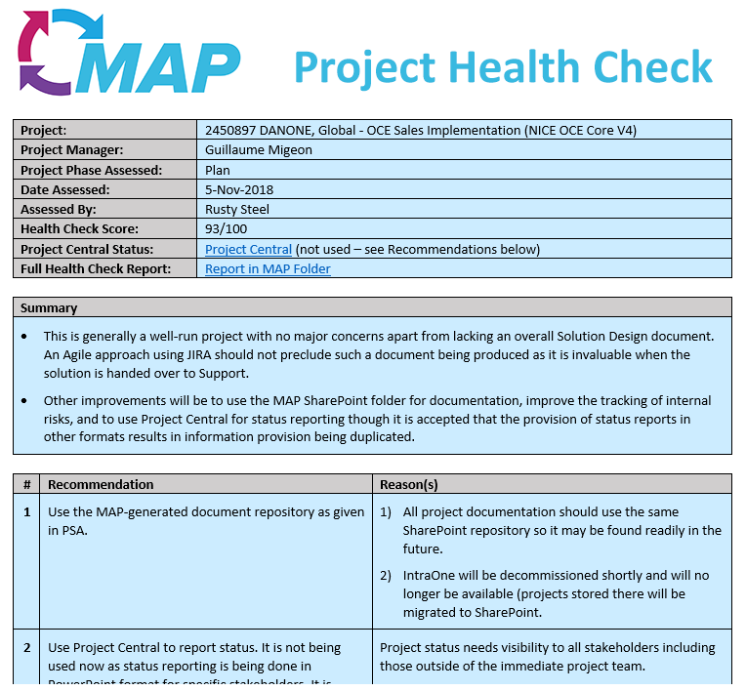
Project Health Checks
A Project Health Check is an inspection or examination of an implementation project to determine how well it is being executed according to the defined process (MAP).
Purpose:
To assess whether MAP is being used to full effect
To validate that the correct deliverables are being produced
To ensure that best practices are being applied
To check that appropriate approvals have been given
To identify shortcomings in MAP for process improvement purposes
Qualifying Projects:
Factors that affect whether a project is subject to health checks:
Value of project (the greater the value, the more likely the project will be health checked)
Size of project (the greater the size, the more likely the project will be health checked)
Client (alignment to client expectations and client management)
Experience of project team (the less experience in the team, the more likely the project will be health checked)
Project timescale (the longer the project timescale, the more likely the project will be health checked)
Complexity of project (the greater the complexity, the more likely the project will be health checked)
HOWEVER, health checks may be carried out on any project at any time

Slide 48
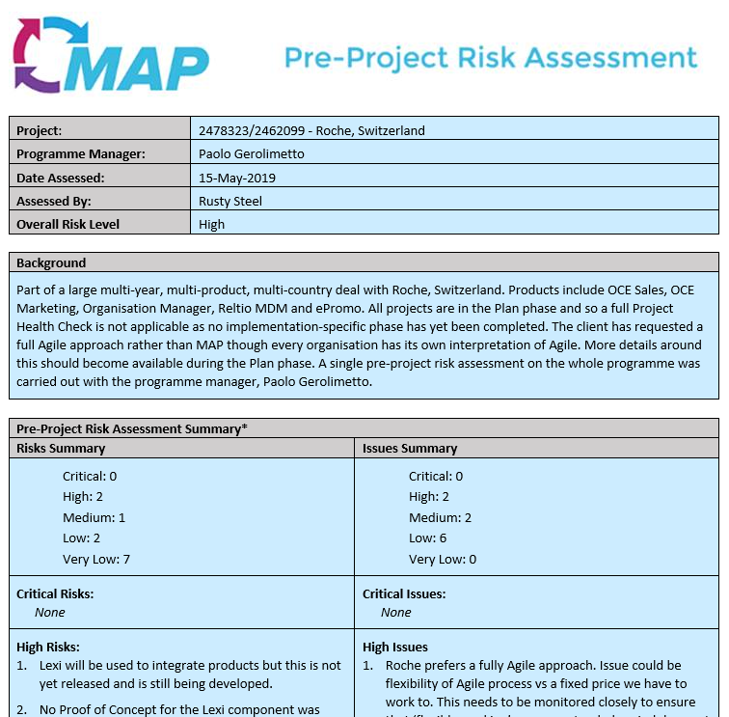
Pre-Project Risk Assessment
A Pre-Project Risk Assessment is an inspection carried out before an implementation project starts
Purpose:
Identify risks and issues before an implementation project starts.
Risks/issues can then be used to pre-populate the project Risks and Issues Log.
Gives advance warning to stakeholders and senior management
Approach:
Uses a ‘guided’ approach to risk identification using a pre-defined set of risks/questions
Interview held with project manager
Uses a score based approach (Probability and Impact)
Report (see example on right) circulated to internal stakeholders and senior management

Slide 49
Tools

Slide 50





Standard Operating Procedures: Tools
Working towards a common use of delivery tools across regions
Tool Names | Uses
 | Platform to manage internal timecards as well as managing project costs and resource utilization
 | Platform to access the MAP site, to view SOPs and to store Client Project documentation and templates
 | Platform to access the IQVIA internal Customer Service Management (CSM) incident management tool and IQVIA external Customer Service Hub (CSH) for self-raising of cases
 | Platform to access the Quality Management System (QMS), storing Standard Operating Procedures (SOPs) and for gaining MAP certification
 | Project status reporting (client and internal), risks/issues management, change and lessons learned logs. The use of Project Central is highly recommended.
Project Management Tool | A number of tools are used including Smartsheet, JIRA, Teamwork, Excel, Project etc. Further information on a standard PM tool will be released in 2019.
Test Management Tool | A number of tools are used including HP Quality Center/ALMS, TestRail, JIRA, Excel etc. Further information on a standard TM tool will be released in 2019.

Slide 51
Timeline & Next Steps

Slide 52
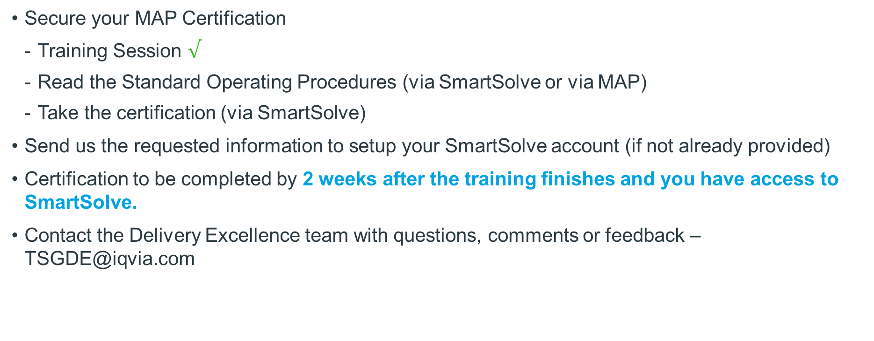
Next Steps
Secure your MAP Certification
Training Session $√$
Read the Standard Operating Procedures (via SmartSolve or via MAP)
Take the certification (via SmartSolve)
Send us the requested information to setup your SmartSolve account (if not already provided)
Certification to be completed by 2 weeks after the training finishes and you have access to SmartSolve.
Contact the Delivery Excellence team with questions, comments or feedback – TSGDE@iqvia.com

Slide 53
QMS Tool: SmartSolve
Acquired from Pilgrim
SmartSolve is the IQVIA standard Quality Management System (QMS) to:
Apply governance on how we store and grant access to our documentation (Standard Operating Procedures, Work Instructions etc)
Achieve compliance from IQVIA users to ensure
Reading and acknowledgement of the content of documents relevant to job role, whether it is via individual documents, or grouped together as part of a training course,
Access to an assessment to test the user’s understanding of the documents
Management of any requests from clients (via audits or RFPs)
SmartSolve will drive our goal of achieving ISO9001 certification targeted for later in 2019

Slide 54
SmartSolve Tips and Tricks
This is the best link to take your SmartSolve certification: https://emea.pilgrimasp.com/prod/smartsolve/login.aspx
There is a 13 question quiz based on an Implementation job role or 15 if you are in Ongoing Support or 25 if you are in a dual role. The pass mark is 70% and you get 3 attempts. If you fail 3 times contact the Delivery Excellence team to reset this for you. SmartSolve Support – Email TSGDE@iqvia.com
Use the SmartSolve How to Guide (MAP Knowledge Center > MAP Training Folder) for step by step screenshots and instructions to help you through your certification.
The quiz is “open book” so you can refer to the MAP SharePoint site and any other MAP training materials.
Managers will be notified that their direct reports have been assigned to do the certification and will be sent reminders to complete ahead of the deadline.
You will need Chrome installed on your PC to use SmartSolve. Please open a VIA ticket if you don’t already have Chrome on your PC. Internet Explorer will work, but not as well.

Slide 55
This training session on Exploring Implementation Processes is now complete and you should be able to:
Understand the Project Phases and the relevant SOPs.
Ensure that the transition from Implementation to Ongoing Support is done correctly.
Identify the Implementation processes that are relevant to your functional role.
Have basic knowledge of MAP tools and governance processes.
Build on the knowledge acquired to gain MAP certification using our SmartSolve system.
Training Objectives

Slide 56
Thank you for your attention
Please contact Delivery Excellence for further information at TSGDE@iqvia.com

